Slide 1


Spectrum Wave Analysis Team
Post Mission Quiz

Slide 2
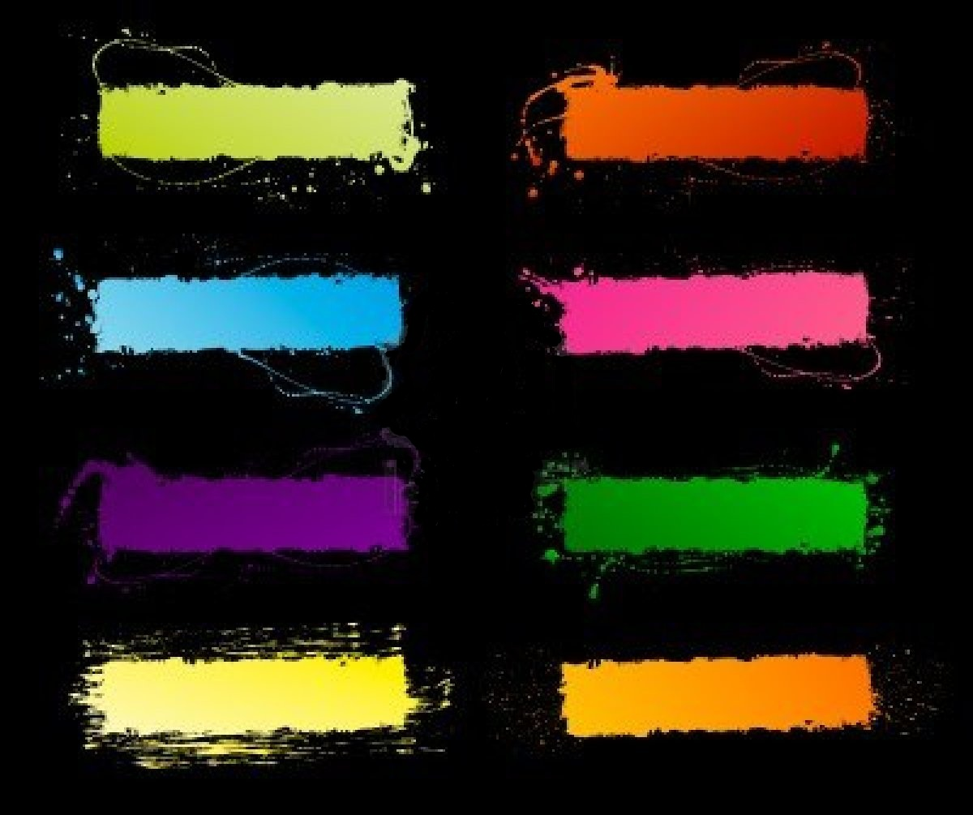
Question #1- Because of this wave we are able to communicate through cell phones.
Radio Waves
Ultraviolet
Microwaves
X-rays
Infrared
Gamma Rays
Visible Light

Slide 3
Question #2- This wave has the highest frequency of all the electromagnetic waves.
Radio Waves
Ultraviolet
Microwaves
X-rays
Infrared
Gamma Rays
Visible Light

Slide 4
Question #3- This wave will help you check for broken bones.
Radio Waves
Ultraviolet
Microwaves
X-rays
Infrared
Gamma Rays
Visible Light

Slide 5
Question #4- This type of wave can be broken down into smaller waves by a prism.
Radio Waves
Ultraviolet
Microwaves
X-rays
Infrared
Gamma Rays
Visible Light

Slide 6
Question #5- These rays are emitted by the sun and can burn the skin.
Radio Waves
Ultraviolet
Microwaves
X-rays
Infrared
Gamma Rays
Visible Light

Slide 7
Question #6- Our eyes are able to see waves in this part of the electromagnetic spectrum.
Radio Waves
Ultraviolet
Microwaves
X-rays
Infrared
Gamma Rays
Visible Light

Slide 8
Question #7-These waves are used to carry signals for radar.
Radio Waves
Ultraviolet
Microwaves
X-rays
Infrared
Gamma Rays
Visible Light

Slide 9
Question #8- These types of waves are used in security systems and night vision goggles.
Radio Waves
Ultraviolet
Microwaves
X-rays
Infrared
Gamma Rays
Visible Light

Slide 10
Question #9- This type of wave is used to inspect luggage at the airport.
Radio Waves
Ultraviolet
Microwaves
X-rays
Infrared
Gamma Rays
Visible Light

Slide 11
Question #10- Any warm object emits this type of wave.
Radio Waves
Ultraviolet
Microwaves
X-rays
Infrared
Gamma Rays
Visible Light

Slide 12
Question #11- This wave enables your body to produce vitamin D.
Radio Waves
Ultraviolet
Microwaves
X-rays
Infrared
Gamma Rays
Visible Light

Slide 13
Question #12- Our remote controls use this type of wave.
Radio Waves
Ultraviolet
Microwaves
X-rays
Infrared
Gamma Rays
Visible Light

Slide 14
Question #13- This type of emission can come from radioactive materials.
Radio Waves
Ultraviolet
Microwaves
X-rays
Infrared
Gamma Rays
Visible Light

Slide 15
Question #14- This wave has the longest wavelength of all the electromagnetic waves.
Radio Waves
Ultraviolet
Microwaves
X-rays
Infrared
Gamma Rays
Visible Light

Slide 16
Question #15- These waves are absorbed by teeth but pass through flesh.
Radio Waves
Ultraviolet
Microwaves
X-rays
Infrared
Gamma Rays
Visible Light

Slide 17
Question #16- This wave is commonly used to cook food.
Radio Waves
Ultraviolet
Microwaves
X-rays
Infrared
Gamma Rays
Visible Light

Slide 18
Question #17- These waves are often used in radiotherapy to kill cancer cells.
Radio Waves
Ultraviolet
Microwaves
X-rays
Infrared
Gamma Rays
Visible Light

Slide 19
Question #18- This type of wave can help detect counterfeit money and security markings on credit cards.
Radio Waves
Ultraviolet
Microwaves
X-rays
Infrared
Gamma Rays
Visible Light

Slide 20
Question #19- Covering up your antenna with foil will stop these waves from reaching your remote control car.
Radio Waves
Ultraviolet
Microwaves
X-rays
Infrared
Gamma Rays
Visible Light

Slide 21
Question #20- This is the main type of wave emitted by light bulbs.
Radio Waves
Ultraviolet
Microwaves
X-rays
Infrared
Gamma Rays
Visible Light

Slide 22
Correct!!!
Return to Question

Slide 23
Sorry, try again!
Return to Question

